Slide 1
Data Warehouse
By,
Edureka

Slide 2
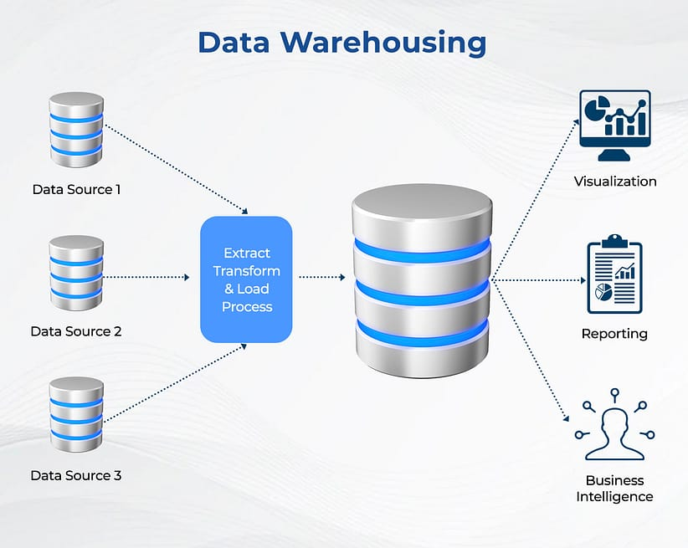
Introduction to Data Warehouse
A data warehouse is a large and centralized repository of data that is used for reporting and analysis. It is designed to support business intelligence (BI) activities by providing a single, unified view of an organization's data. Data warehouses typically integrate data from multiple sources, including operational systems, external sources, and other data warehouses.

Slide 3
Introduction cont.
Purpose of a data warehouse is to provide reliable and accurate source of information for decision-making processes.
This is achieved by transforming and consolidating data from various sources into a consistent format that can be easily queried and analyzed.
Data warehouses are optimized for read-intensive operations and are designed to handle large amounts of data.

Slide 4
Introduction cont.
The data in a data warehouse is structured in a way that is optimized for analytical processing.
This typically involves organizing the data into fact tables and dimension tables.
Fact Tables:
Fact tables contain the quantitative data that is being analyzed, such as sales figures or customer transactions.
Dimension Tables:
Dimension tables provide context for the data in the fact tables, such as product or customer information.

Slide 5
Introduction cont.
Data warehouses are typically used in conjunction with BI tools, such as dashboards, reports, and ad hoc queries.
These tools enable users to analyze and visualize the data stored in the data warehouse, allowing them to gain insights and make informed decisions based on the data.

Slide 6
Why should we consider Data Warehousing solutions ?

Slide 7
There are several reasons why organizations should consider implementing a data warehousing solution:
Better decision-making
Improved data quality
Faster query performance
Scalability
Compliance and governance

Slide 8
Better decision-making:
A data warehouse provides a single source of truth for an organization's data. By integrating data from multiple sources and providing a consistent view of the data, a data warehouse makes it easier for decision-makers to access and analyze the data they need to make informed decisions.
Improved data quality:
Data warehouses typically have a rigorous data integration process that involves cleaning, transforming, and consolidating data from multiple sources. This can help to improve the quality and accuracy of the data, which is critical for decision-making processes.
Faster query performance:
Data warehouses are designed to optimize query performance for read-intensive operations. This means that users can query large amounts of data quickly and efficiently, without impacting the performance of other systems.
Scalability:
As organizations grow and their data volumes increase, a data warehouse can be scaled up to handle larger amounts of data. This makes it easier for organizations to adapt to changing business needs and to support their growth.
Compliance and governance:
A data warehouse can help organizations to comply with regulations and industry standards by providing a centralized and controlled environment for managing data. This can help to reduce the risk of data breaches and ensure that sensitive data is handled appropriately.

Slide 9
Data Warehouse concepts
Granularity
Aggregation
Conformed Dimensions
Slowly Changing Dimensions (SCD)
Data Warehouse Schema
Data Mart
Data Lineage
Partitioning
Dimensional Modelling

Slide 10
Granularity:
The level of detail at which data is stored in a data warehouse. The granularity can range from a high level, such as quarterly sales data, to a low level, such as individual transactions.
Aggregation:
The process of combining and summarizing data from multiple sources into a more concise and manageable form for analysis. Aggregation can improve query performance and reduce the amount of storage required for data.
Conformed Dimensions:
Dimensions that have the same structure and meaning across different areas of the data warehouse. Conformed dimensions allow for consistent analysis across different subject areas.

Slide 11
Slowly Changing Dimensions (SCD):
Dimensions that change over time, such as customer or product information. SCDs are classified into different types based on how the dimension changes, and are managed using specific techniques to maintain the historical accuracy of the data.
Data Warehouse Schema:
The logical or physical structure of a data warehouse. There are different types of schemas, such as star schema, snowflake schema, and hybrid schema, that are designed to meet different requirements for querying and analyzing data.
Data Mart:
A subset of a data warehouse that is designed to serve a specific business function or department, such as sales or finance. Data marts are smaller and more focused than a data warehouse, and can be built using a subset of the data from the larger data warehouse.

Slide 12
Data Lineage:
The process of tracing the origin, movement, and transformation of data within a data warehouse. Data lineage is important for ensuring data accuracy and compliance, and can help with troubleshooting and debugging issues.
Partitioning:
The process of dividing large tables into smaller, more manageable parts. Partitioning can improve query performance and reduce the amount of storage required for data.
Dimensional Modeling:
A design approach for building data warehouses that emphasizes the use of dimensions and fact tables to organize and store data. Dimensional modeling is optimized for query performance and ease of use, and is widely used in data warehousing.

Slide 13
Data Warehouse terminologies
Query:
A request for information from a data warehouse. Queries are used to retrieve data for analysis and reporting.
Cube:
A multi-dimensional structure used for storing and querying data in a data warehouse. A cube allows for fast and efficient analysis of large data sets.
Drill-Down:
The ability to view data at a more detailed level by navigating from a summary view to a more granular view of the data.
Roll-Up:
The ability to aggregate data from a more granular level to a higher level of abstraction.
Star Join:
A join operation that links a fact table to a single dimension table in a star schema.

Slide 14
Data Warehouse terminologies
Snowflake Join:
A join operation that links a fact table to a dimension table that is normalized into multiple tables in a snowflake schema.
Extract:
The process of copying data from source systems into a data warehouse.
Transform:
The process of converting and preparing data for analysis in a data warehouse. This can include cleaning, consolidating, and formatting the data.
Load:
The process of inserting data into a data warehouse after it has been extracted and transformed.
Data Integration:
The process of combining data from multiple sources into a unified view in a data warehouse.

Slide 15
Data Warehouse terminologies
Data Mart Bus Matrix:
A matrix that maps the relationships between data marts and business functions within an organization.
Staging Area:
A temporary storage area used for storing data before it is transformed and loaded into a data warehouse.
Data Warehouse Appliance:
A pre-configured and optimized hardware and software system for hosting a data warehouse.
Data Warehouse as a Service (DWaaS):
A cloud-based service that provides data warehousing capabilities without the need for on-premise hardware and software.

Slide 16
Data Warehouse terminologies
Fact Table:
A table in a data warehouse that contains quantitative data, such as sales figures or customer transactions.
Dimension Table:
A table in a data warehouse that provides context for the data in the fact tables, such as product or customer information.
Star Schema:
A schema in which one or more fact tables are connected to several dimension tables in a star-like structure.
Snowflake Schema:
A schema in which the dimension tables are normalized into multiple tables, creating a snowflake-like structure.
OLAP (Online Analytical Processing):
A method of querying and analyzing data in a data warehouse that allows users to drill down into the data and view it from different perspectives.

Slide 17
Data Warehouse terminologies
Data Mart:
A subset of a data warehouse that is designed to serve a specific business function, such as sales or marketing.
Metadata: Data about data.
In the context of a data warehouse, metadata includes information about the structure and meaning of the data.
Data Mining:
The process of using statistical techniques and algorithms to discover patterns and relationships in data.
Data Governance:
The process of managing the availability, usability, integrity, and security of an organization's data assets.

Slide 18
OLTP
OLTP stands for Online Transaction Processing.
It is a type of database system designed for processing and managing transaction-oriented applications such as online banking, point of sale (POS) systems, and e-commerce websites.
OLTP databases are optimized for fast and efficient transaction processing, which involves inserting, updating, and deleting small amounts of data in real-time.
The data is organized into tables with strict data integrity constraints and normalized to eliminate data redundancy.

Slide 19
OLTP cont.
OLTP databases typically use the ACID (Atomicity, Consistency, Isolation, Durability) properties to ensure data consistency and reliability.
Atomicity ensures that each transaction is treated as a single unit of work
Consistency ensures that the database is in a valid state before and after each transaction
Isolation ensures that multiple transactions can be executed simultaneously without interfering with each other
Durability ensures that once a transaction is committed, the changes are permanent and cannot be lost.

Slide 20
OLTP cont.
OLTP databases are
optimized for read and write operations
Typically store a small amount of data compared to data warehouses.
Designed to handle high transaction volumes
Provide quick and reliable access to data for end-users.

Slide 21
OLAP
OLAP stands for Online Analytical Processing.
It is a technique for analyzing large volumes of multidimensional data from multiple perspectives, such as time, geography, product, or customer.
OLAP provides a flexible and interactive way to query and analyze data in a data warehouse.
It allows users to drill down into the data and view it from different angles or dimensions, enabling them to gain insights and make better decisions.

Slide 22
OLAP cont.
OLAP data is stored in cubes, which are multi-dimensional structures that contain measures (such as sales, revenue, or profit) and dimensions (such as time, product, or location).
The cube structure provides a way to organize and store large amounts of data in a format that is optimized for query performance and ease of use.
OLAP tools typically provide a graphical user interface that allows users to interact with the data using drag-and-drop operations or point-and-click selections.
Users can create custom reports, charts, and dashboards to visualize the data in different ways, and can drill down or roll up the data to see more or less detail.

Slide 23
Difference between OLTP and OLAP
OLTP and OLAP (Online Analytical Processing) are two different types of database systems designed for different purposes. Here are some key differences between OLTP and OLAP:
Purpose:
OLTP databases are designed for transaction-oriented applications such as online banking, point of sale (POS) systems, and e-commerce websites, where the focus is on real-time transaction processing. OLAP databases, on the other hand, are designed for analytical applications such as business intelligence (BI) and data mining, where the focus is on analyzing large volumes of historical data.
Data Size:
OLTP databases typically store a relatively small amount of data, while OLAP databases store much larger amounts of data. OLTP databases focus on individual transactions and maintain a high degree of data normalization, while OLAP databases focus on aggregating data from multiple sources and organizing it into multidimensional structures for efficient querying and analysis.

Slide 24
Difference between OLTP and OLAP
Data Structure:
OLTP databases use normalized data structures to minimize data redundancy and ensure data consistency, while OLAP databases use denormalized data structures such as cubes or star schemas to enable fast and efficient querying and analysis.
Querying and Reporting:
OLTP databases are optimized for transaction processing and simple querying, while OLAP databases are optimized for complex querying and ad-hoc reporting. OLAP databases provide users with powerful tools to analyze data from multiple perspectives and dimensions.
Performance:
OLTP databases are optimized for fast transaction processing and maintain high levels of data integrity, while OLAP databases are optimized for fast and efficient querying and analysis.

Slide 25
Types of OLAP
Multidimensional OLAP (MOLAP):
MOLAP stores data in multidimensional cubes, which are pre-aggregated and stored in memory or on disk. MOLAP provides fast query performance and high interactivity, making it ideal for small to medium-sized datasets. MOLAP is the most traditional form of OLAP, and it is widely used for business intelligence and data mining applications.
Relational OLAP (ROLAP):
ROLAP stores data in a relational database, such as SQL Server or Oracle. ROLAP provides greater scalability and flexibility than MOLAP, and it can handle larger datasets. ROLAP retrieves data from the underlying relational database and uses SQL queries to aggregate and summarize the data. ROLAP is ideal for large-scale data warehousing applications.
Hybrid OLAP (HOLAP):
HOLAP combines the benefits of MOLAP and ROLAP by using both multidimensional cubes and relational databases. HOLAP stores the most frequently accessed data in memory as multidimensional cubes, while less frequently accessed data is stored in a relational database. HOLAP provides fast query performance and the ability to handle large datasets, making it ideal for data warehousing applications.

Slide 26
Types of OLAP cont.
MOLAP, ROLAP, and HOLAP are three different types of OLAP, each with its own strengths and weaknesses.
MOLAP is ideal for small to medium-sized datasets
ROLAP is ideal for large-scale data warehousing applications
HOLAP provides the best of both worlds by using both multidimensional cubes and relational databases

Slide 27
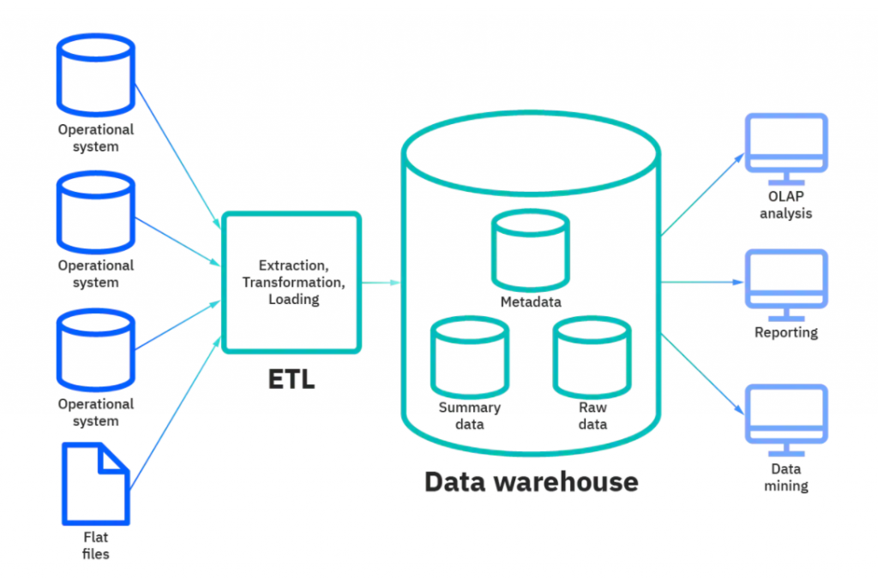
Data Warehouse Architecture

Slide 28
Types of Schemas
Star Schema:
The star schema is the simplest and most widely used schema in data warehousing. In this schema, a fact table is surrounded by dimension tables, which represent the attributes of the data being analyzed. The fact table contains the measures or metrics, and the dimension tables contain the descriptive data.
Snowflake Schema:
The snowflake schema is an extension of the star schema. In this schema, the dimension tables are normalized, meaning that they are divided into sub-tables. This can lead to more efficient storage and better performance, but it can also make the schema more complex.
Galaxy Schema:
The galaxy schema is a combination of the star and snowflake schema. It allows for more flexibility in representing complex data relationships, but can also be more difficult to understand and maintain.

Slide 29
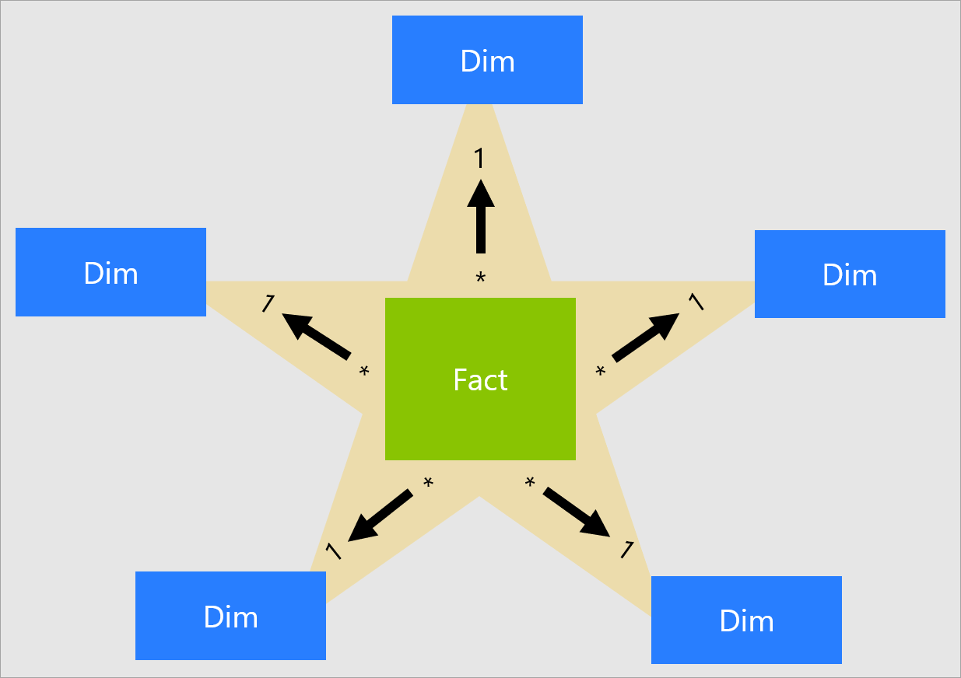
Star Schema

Slide 30
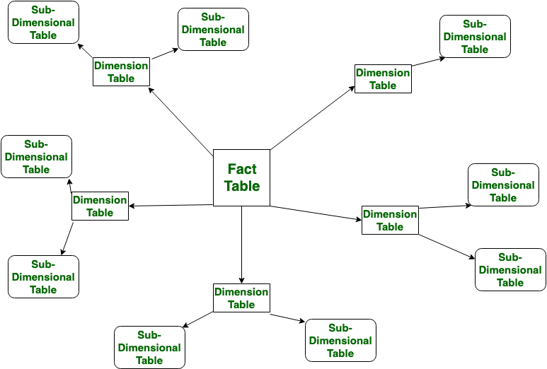
Snowflake Schema

Slide 31
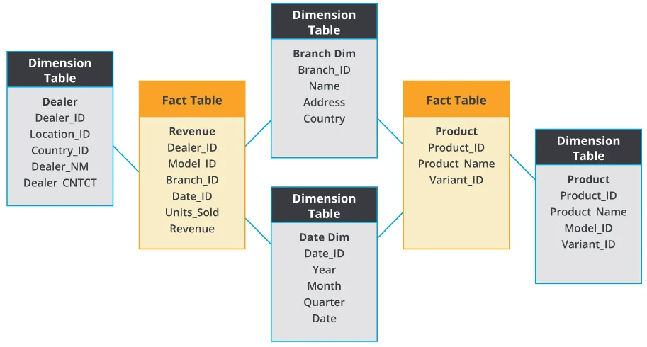
Galaxy Schema

Slide 32
Facts & Dimensions
Fact:
A fact is a measurable quantity or event that represents some aspect of a business process.
Examples - sales revenue, units sold, and customer orders.
Facts are typically numeric and can be aggregated and analyzed over time to identify trends and patterns.
Dimension:
A dimension is a descriptive attribute that provides context for a fact.
Dimensions are used to group, filter, and aggregate facts.
Examples - time, location, product, and customer.
Dimensions can be hierarchical, meaning that they can be organized into levels of increasing granularity. For example, a time dimension might be organized into years, quarters, months, and days.

Slide 33
Slowly Changing Dimensions (SCD)
SCD, or slowly changing dimensions, is a technique used in data warehousing to manage changes to data over time.
In many cases, data in a data warehouse is not static and can change frequently. SCD techniques allow for tracking and managing these changes, so that historical data can be preserved and used for analysis.

Slide 34
Types of Slowly Changing Dimensions
There are 3 main types of SCD:
Type 1:
In this type of SCD, the old value of a dimension attribute is simply overwritten with the new value. This approach is best used when the historical value of an attribute is not important and can be safely discarded. However, it should be noted that this approach does not preserve historical data.
Type 2:
In this type of SCD, a new record is created in the dimension table when a change is made. This allows for historical data to be preserved and tracked over time. Each record is assigned a unique identifier, such as a surrogate key, and is given an effective date range to indicate when the record was valid. This approach can result in a larger database size, but provides a more complete picture of historical data.
Type 3:
In this type of SCD, the current and previous values of a dimension attribute are stored in the same record. This allows for some historical tracking, but is generally less comprehensive than type 2 SCD. This approach is best used when only a limited amount of historical tracking is required.

Slide 35
Metadata
Metadata is data that describes other data.
It provides information about the structure, content, and context of data, and helps users understand and manage it.
Metadata can include a wide range of information, such as data types, field names, data source, author, date created, and data relationships.
In the context of data warehousing, metadata is particularly important, as it helps users understand the structure and contents of the data warehouse.
Metadata can include information about the data sources used to populate the warehouse, the ETL processes used to transform the data, the schema and tables used in the warehouse, and the business rules and logic applied to the data.

Slide 36
Types of Metadata
There are several types of metadata in data warehousing:
Technical metadata:
Technical metadata provides information about the technical aspects of the data warehouse, such as the database schema, table structure, and data types.
Operational metadata:
Operational metadata provides information about the day-to-day operation of the data warehouse, such as ETL job schedules and performance metrics.
Business metadata:
Business metadata provides information about the business context of the data in the warehouse, such as business rules and data definitions.
Usage metadata:
Usage metadata provides information about how the data in the warehouse is used, such as query history and user access patterns.

Slide 37
Metadata Concepts
Data dictionary:
Metadata repository:
Data lineage:
Data profiling:
Business glossary:
Impact analysis:

Slide 38
Metadata Concepts
Data dictionary:
A data dictionary is a repository of metadata that provides a centralized location for storing and managing information about data elements, such as table names, column names, data types, and business rules.
Metadata repository:
A metadata repository is a centralized database that stores metadata information for a data warehouse, including data definitions, data lineage, and data quality rules. It serves as a single source of truth for metadata information, allowing for better collaboration and governance.
Data lineage:
Data lineage is the history of the movement of data from its original source to its final destination. It includes information about the data's transformations, mappings, and usage over time.

Slide 39
Metadata Concepts
Data profiling:
Data profiling is the process of analyzing and examining data to identify patterns, relationships, and quality issues. It involves reviewing metadata to understand the structure and content of the data.
Business glossary:
A business glossary is a collection of business terms and definitions used within an organization. It provides a common language for understanding and communicating business concepts and can be used to establish consistency in metadata across the organization.
Impact analysis:
Impact analysis is the process of identifying the potential effects of a change to data or metadata. It involves analyzing the relationships and dependencies between data elements to understand how changes may impact downstream processes.

Slide 40
Data Mart
Data Mart is a subset of data warehousing that involves creating smaller, departmental-level data warehouses that focus on specific business functions or areas.
Unlike a traditional data warehouse, which is designed to serve the needs of an entire organization, a data mart is designed to meet the needs of a specific group of users, such as sales, marketing, or finance.
Data marts are typically smaller than traditional data warehouses and are designed to be easier to use and maintain.
They are often built using a dimensional model and include only the data that is relevant to the business area or function that they support.
This can make it easier for users to access and analyze data, as they don't have to sift through large amounts of irrelevant information.

Slide 41
Benefits of Data Mart
There are several benefits to using data marts, including:
Improved data quality:
By focusing on specific business functions or areas, data marts can ensure that the data being used is accurate, relevant, and up-to-date.
Increased efficiency:
Data marts can be designed and implemented more quickly and easily than traditional data warehouses, allowing organizations to get the information they need faster.
Cost savings:
Data marts can be less expensive to build and maintain than traditional data warehouses, as they are smaller in scope and don't require as much infrastructure.
Improved decision-making:
By providing users with access to relevant data, data marts can help improve decision-making across the organization.

Slide 42
ETL
ETL stands for Extract, Transform, and Load.
It is a process used in data warehousing to move data from source systems into a data warehouse

Slide 43
ETL cont.
Extract:
In the extract phase, data is extracted from source systems, which can include databases, flat files, and web services.
The data is typically selected based on certain criteria, such as a date range or a specific set of data fields.
Transform:
In the transform phase, the data is transformed into a format that is suitable for loading into the data warehouse.
This can involve a range of data transformations, such as filtering, cleaning, aggregating, and joining data from multiple sources.
Load:
In the load phase, the transformed data is loaded into the data warehouse.
This can involve loading data into staging tables first and then moving it into final destination tables using SQL statements.

Slide 44
ETL Implementation
Implementing an ETL process involves a number of steps, including the following:
Identify the source data:
The first step in implementing an ETL process is to identify the source data that will be used to populate the data warehouse. This can include data from a variety of sources, such as databases, flat files, and web services.
Design the data model:
Once the source data has been identified, the next step is to design the data model for the data warehouse. This involves identifying the tables and columns that will be used to store the data, as well as the relationships between them.
Create the ETL jobs:
With the data model in place, the next step is to create the ETL jobs that will extract data from the source systems, transform it into the desired format, and load it into the data warehouse. This can involve using a variety of tools and technologies, such as SQL, scripting languages like Python or Perl, and ETL platforms like Informatica or Talend.
Test and validate the ETL process:
Once the ETL jobs have been created, it's important to test and validate the process to ensure that it is working correctly. This can involve running test loads with sample data, validating the data in the data warehouse, and troubleshooting any issues that arise.
Monitor and maintain the ETL process:
After the ETL process has been implemented, it's important to monitor and maintain it to ensure that it continues to work correctly over time. This can involve monitoring data quality, troubleshooting issues, and making changes to the ETL process as needed to accommodate changing business requirements.

Slide 45
ETL Tools
There are many ETL Tools in the market, some of the popular ones are:
Informatica PowerCenter:
Informatica PowerCenter is a widely used ETL tool that can extract data from various sources, transform it, and load it into a target database or data warehouse. It supports both batch and real-time data integration and offers a graphical interface for designing ETL workflows.
Microsoft SQL Server Integration Services (SSIS):
SSIS is an ETL tool that is part of the Microsoft SQL Server suite. It can extract data from various sources, transform it, and load it into a target database or data warehouse. It offers a graphical interface for designing ETL workflows and supports both batch and real-time data integration.
Talend:
Talend is an open-source ETL tool that can extract data from various sources, transform it, and load it into a target database or data warehouse. It offers a graphical interface for designing ETL workflows and supports both batch and real-time data integration. Talend also offers a cloud-based ETL platform called Talend Cloud.
IBM InfoSphere DataStage:
IBM InfoSphere DataStage is an ETL tool that can extract data from various sources, transform it, and load it into a target database or data warehouse. It offers a graphical interface for designing ETL workflows and supports both batch and real-time data integration. InfoSphere DataStage also offers data quality and data governance features.
Apache NiFi:
Apache NiFi is an open-source ETL tool that can extract data from various sources, transform it, and load it into a target database or data warehouse. It offers a visual interface for designing data flows and supports both batch and real-time data integration. NiFi also offers data routing and transformation capabilities.
Pentaho Data Integration:
Pentaho Data Integration is an open-source ETL tool that can extract data from various sources, transform it, and load it into a target database or data warehouse. It offers a graphical interface for designing ETL workflows and supports both batch and real-time data integration. Pentaho Data Integration also offers data profiling and data quality features.

Slide 46
ETL Tool Functions
ETL tools automate the ETL process by providing a set of features and functionalities that facilitate the movement and transformation of data.
Here are some common functions of ETL tools:
Extraction:
ETL tools can extract data from various sources such as databases, files, APIs, and web services. They can connect to different data sources and retrieve data using predefined SQL queries or scripts.
Transformation:
ETL tools can transform the extracted data to fit the format and structure of the target database or data warehouse. They can perform various data manipulation tasks such as filtering, sorting, aggregating, merging, and joining.
Data cleaning:
ETL tools can perform data cleaning tasks such as removing duplicates, handling missing values, and correcting errors.

Slide 47
ETL Tool Functions
Data enrichment:
ETL tools can enrich the data by adding new fields, combining data from multiple sources, and enhancing the data with additional information.
Data validation:
ETL tools can validate the data to ensure its accuracy, completeness, and consistency. They can perform various data quality checks such as data profiling, data matching, and data cleansing.
Data integration:
ETL tools can integrate data from multiple sources into a single target database or data warehouse. They can handle complex data integration scenarios such as incremental updates, real-time data streaming, and data synchronization.
Workflow automation:
ETL tools can automate the entire ETL process by providing a visual interface for designing and scheduling ETL workflows. They can also provide monitoring and error handling capabilities to ensure the smooth execution of ETL jobs.

Slide 48
Data Validation
Data validation is the process of ensuring that the data is accurate, complete, and consistent.
It involves verifying the data against predefined rules and standards to detect errors, inconsistencies, and missing values.
Data validation is an essential step in the data integration process and helps to improve the quality of the data.

Slide 49
Data Validation Techniques
Here are some common data validation techniques:
Data profiling
Data matching
Data cleansing
Data enrichment
Data validation rules
Data profiling tools

Slide 50
Data profiling:
Data profiling is the process of analyzing the data to understand its structure, content, and quality. It involves collecting statistics and metrics such as data type, distribution, cardinality, and completeness. Data profiling helps to identify data anomalies and inconsistencies.
Data matching:
Data matching is the process of comparing data from different sources to identify duplicate records. It involves applying fuzzy matching algorithms and similarity measures to detect similar records.
Data cleansing:
Data cleansing is the process of correcting errors and inconsistencies in the data. It involves applying data transformation rules to standardize the data, remove duplicates, and fill in missing values.

Slide 51
Data enrichment:
Data enrichment is the process of adding new information to the data to enhance its value. It involves integrating data from external sources such as social media, customer feedback, and third-party databases.
Data validation rules:
Data validation rules are predefined rules that the data must adhere to. These rules can be simple checks such as data type and format, or complex checks such as referential integrity and business rules. Data validation rules help to ensure that the data is consistent and accurate.
Data profiling tools:
Data profiling tools are software applications that automate the data profiling process. These tools can scan the data and generate reports that highlight data anomalies and inconsistencies. They can also provide visualization and exploration capabilities to help users understand the data.

